Slide 1
Mathematical Induction

Slide 2
Proof Technique
Proof of quantified statements:
• There exists x with some property P(x).
– It is sufficient to find one element for which the property holds.
• For all x some property P(x) holds.
– Proofs of ‘For all x some property P(x) holds’ must cover all x and can be harder.
Mathematical induction is a technique that can be applied to prove the universal statements for sets of positive integers or their associated sequences.
Notes:
Book typically starts with n=1 instead of n=0. Starting point is arbitrary.

Slide 3
Mathematical Induction
Used to prove statements of the form where x ϵ Z+
Mathematical induction proofs consists of two steps:
1) Basis: The proposition P(1) is true.
2) Inductive Step: The implication
P(n) → P(n+1), is true for all positive n.
• Therefore we conclude
Notes:
Book typically starts with n=1 instead of n=0. Starting point is arbitrary.

Slide 4
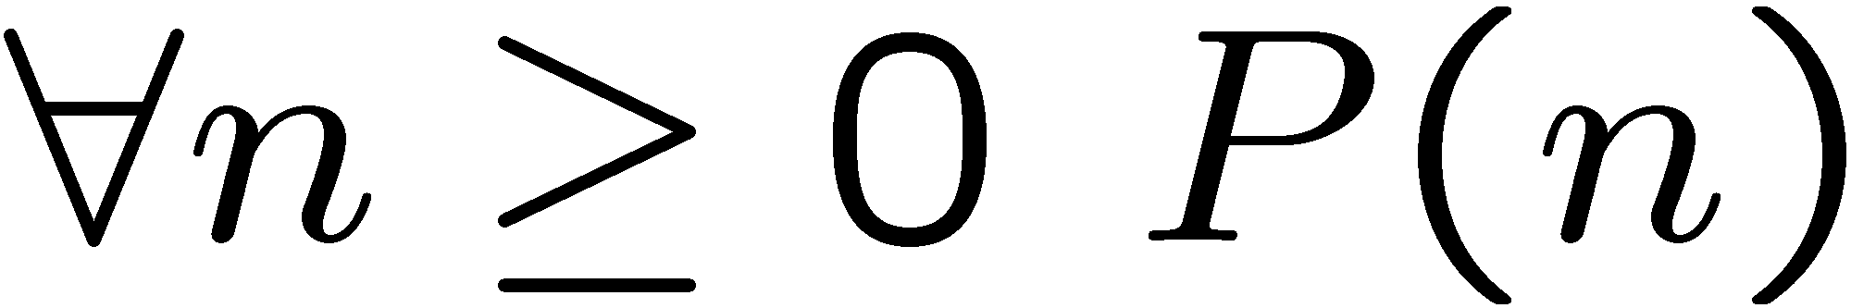
Idea of Induction
Objective: Prove
This is to prove
The idea of induction is to first prove P(0) unconditionally,
then use P(0) to prove P(1)
then use P(1) to prove P(2)
and repeat this to infinity…

Slide 5

Mathematical Induction
So sequence of propositions is a sequence of dominos.
P (0)
P (1)
P (2)
P (n)
P (n+1)
…

Slide 6

Mathematical Induction
Then can conclude that all the dominos fall!
P (0)
true
P (1)
true
P (2)
true
…
P (n)
true
P (n+1)
true

Slide 7
Mathematical Induction
Example: Prove that, 1+2+3+....+n = n(n+1)/2 , for n belongs to Z, n>=1
Solution:
Step 1 (Basis Step): P(1) is true as 1 = 1(1+1)/2 = 1.
Step 2 (Induction Step):
Assume, 1 + 2 + 3 + … + k = k(k+1)/2 is true. (Induction Hypothesis)
Now, We need to prove,
1 + 2 + 3 + … + (k+1) = (k+1)(k+2)/2. (replacing n with k +1)
1 + 2 + 3 + … + k + (k+1) = (k+1)(k+2)/2
k(k+1)/2 + (k+1) = (k+1)(k+2)/2
(k² + k)/2 + k + 1 = (k² + 2k + k + 2)/2
(k² + 2k + k + 2)/2 = (k² + 2k + k + 2)/2
PROVED
Notes:
7
Book typically starts with n=1 instead of n=0. Starting point is arbitrary.

Slide 8
Mathematical Induction
Example: Prove the sum of first n odd integers is n² .
i.e. 1 + 3 + 5 + 7 + ... + (2n - 1) = n² for all positive integers.
Proof:
• What is P(n)?
P(n): 1 + 3 + 5 + 7 + ... + (2n - 1) = n²
Notes:
Book typically starts with n=1 instead of n=0. Starting point is arbitrary.

Slide 9
Mathematical Induction
Basis Step Show P(1) is true
Trivial: 1 = 1²
Inductive Step
Show if P(n) is true then P(n+1) is true for all n.
• Suppose P(n) is true,
that is 1 + 3 + 5 + 7 + ... + (2n - 1) = n²
• Show P(n+1):
1 + 3 + 5 + 7 + ... + (2n - 1) + (2n + 1) = (n+1)²
follows:
• 1 + 3 + 5 + 7 + ... + (2n - 1) + (2n + 1) = n² + (2n+1)
= (n+1)²
Notes:
Book typically starts with n=1 instead of n=0. Starting point is arbitrary.

Slide 10
Mathematical Induction
Example: Prove n³ - n is divisible by 3 for all positive integers.
P(n): n³ - n is divisible by 3
Basis Step: P(1): 1³ - 1 = 0 is divisible by 3 (obvious)
Inductive Step: If P(n) is true then P(n+1) is true for each
positive integer.
• Suppose P(n): n³ - n is divisible by 3 is true.
• Show P(n+1): (n+1)³ - (n+1) is divisible by 3.
(n+1)³ - (n+1) = n³ + 3n² + 3n + 1 - n - 1
= (n³ - n) + 3n² + 3n
= (n³ - n) + 3(n² + n)
Divisible by 3
Divisible by 3
Notes:
Book typically starts with n=1 instead of n=0. Starting point is arbitrary.

Slide 11
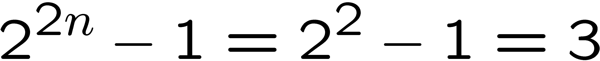
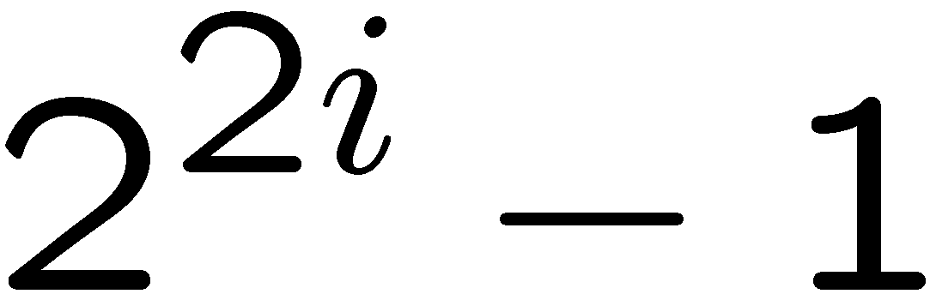
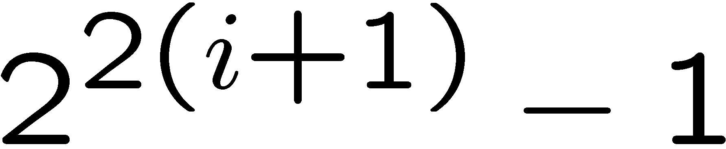
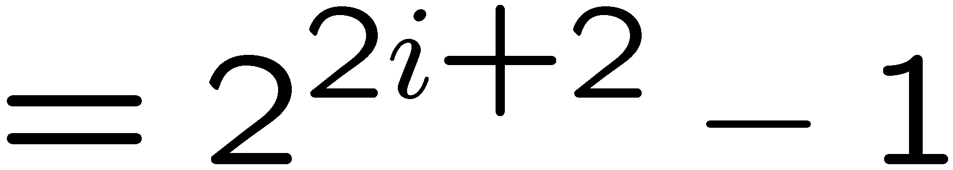
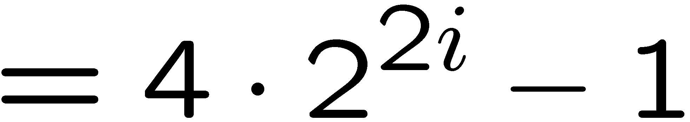
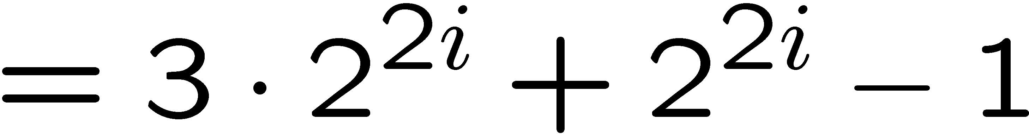
Proving a Property
Base Case (n = 1):
Induction Step: Assume P(i) for some i ≥ 1 and prove P(i + 1):
Assume
is divisible by 3, prove
is divisible by 3.
Divisible by 3
Divisible by 3 by induction

Slide 12
Mathematical Induction
Example: Prove than 2^{n} < n! for all n ≥ 4.
Basis Step: P(4) = 2⁴ < 4! =16 < 24 (trivial)
Inductive Step:
If P(n) is true then P(n+1) is also true
2^{n+1} = 2 . 2^{n}
< 2. n! (P(n) is true)
< (n+1)n! (2<n+1)
= (n+1)!
Notes:
Book typically starts with n=1 instead of n=0. Starting point is arbitrary.

Slide 13
Strong Induction
The regular induction:
– basis step P(1) and
– inductive step P(n-1) → P(n)
• Strong induction uses:
– basis step P(1) and
– inductive step P(1) and P(2) … P(n-2) and P(n-1) → P(n)
Example: Show that a positive integer greater than 1 can be written as a product of primes.
Notes:
Book typically starts with n=1 instead of n=0. Starting point is arbitrary.

Slide 14
Strong Induction
Show that a positive integer greater than 1 can be written as a product of primes.
Basis step: P(2) is true
Inductive step: Assume true for P(2), P(3), … P(n)
Show that P(n+1) is true as well.
2 Cases:
If n+1 is a prime then P(n+1) is trivially true
If n+1 is a composite then it can be written as a product of two integers (n+1) = a*b such that 1< a ,b < n+1
From the assumption P(a) and P(b) holds.
• Thus, n+1 can be written as a product of primes
• End of proof
Notes:
14
Book typically starts with n=1 instead of n=0. Starting point is arbitrary.

Slide 15
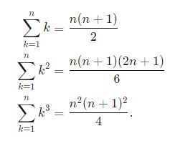
Homeworks

Slide 16
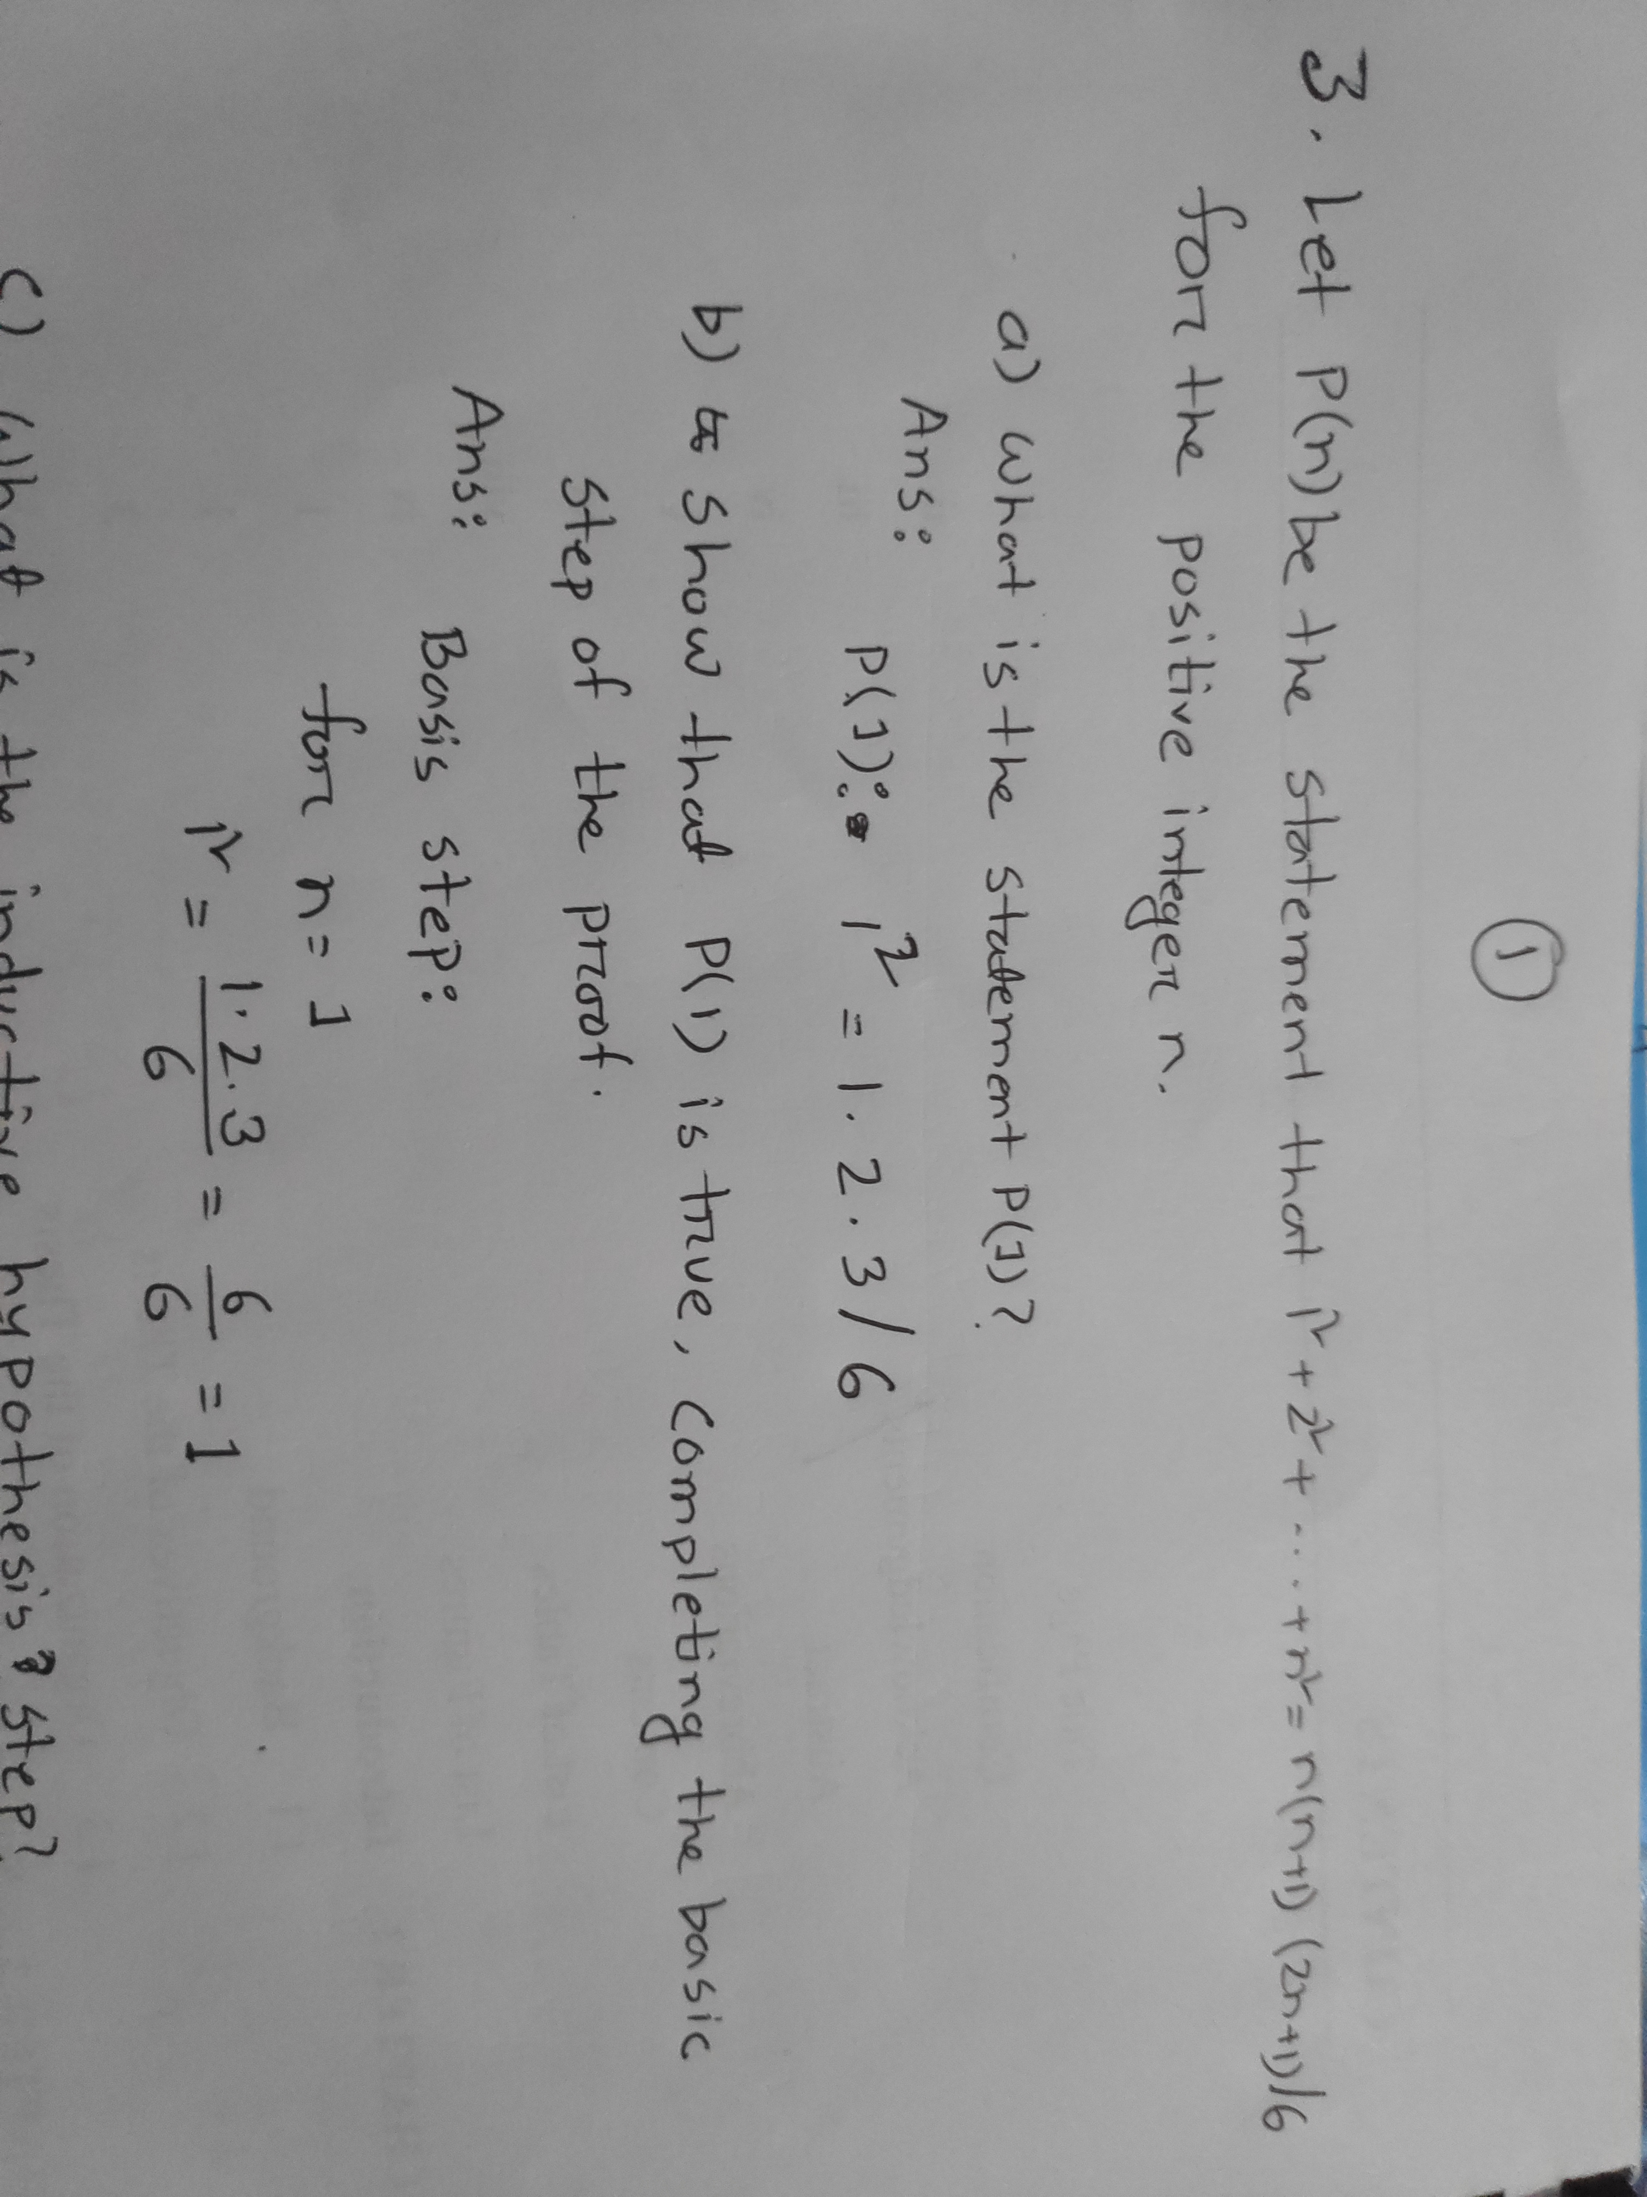

Slide 17
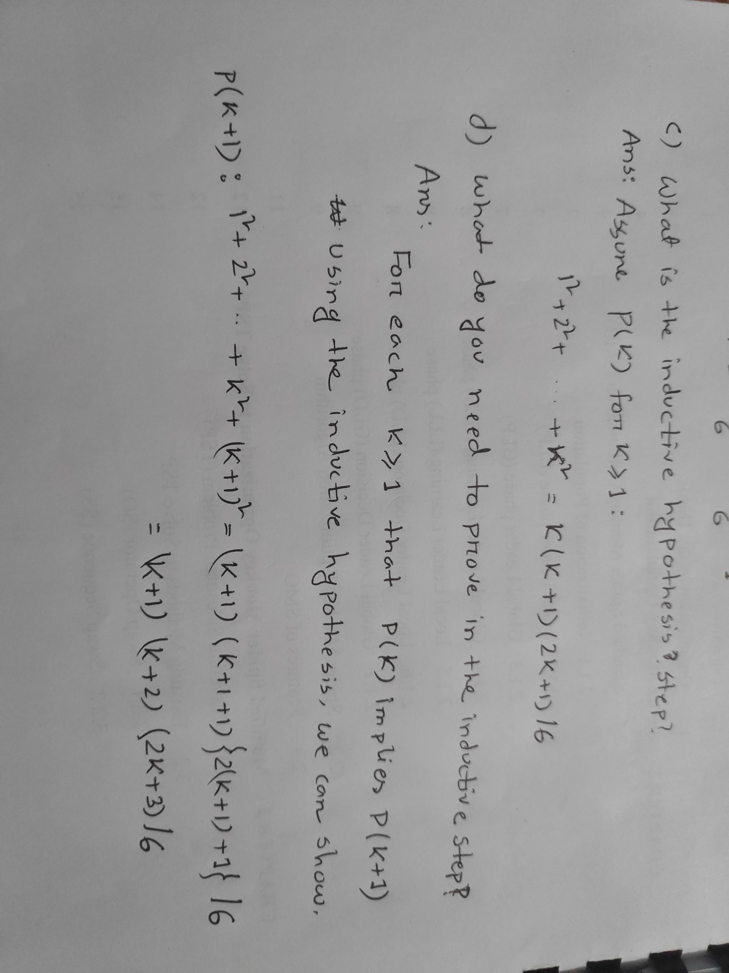

Slide 18
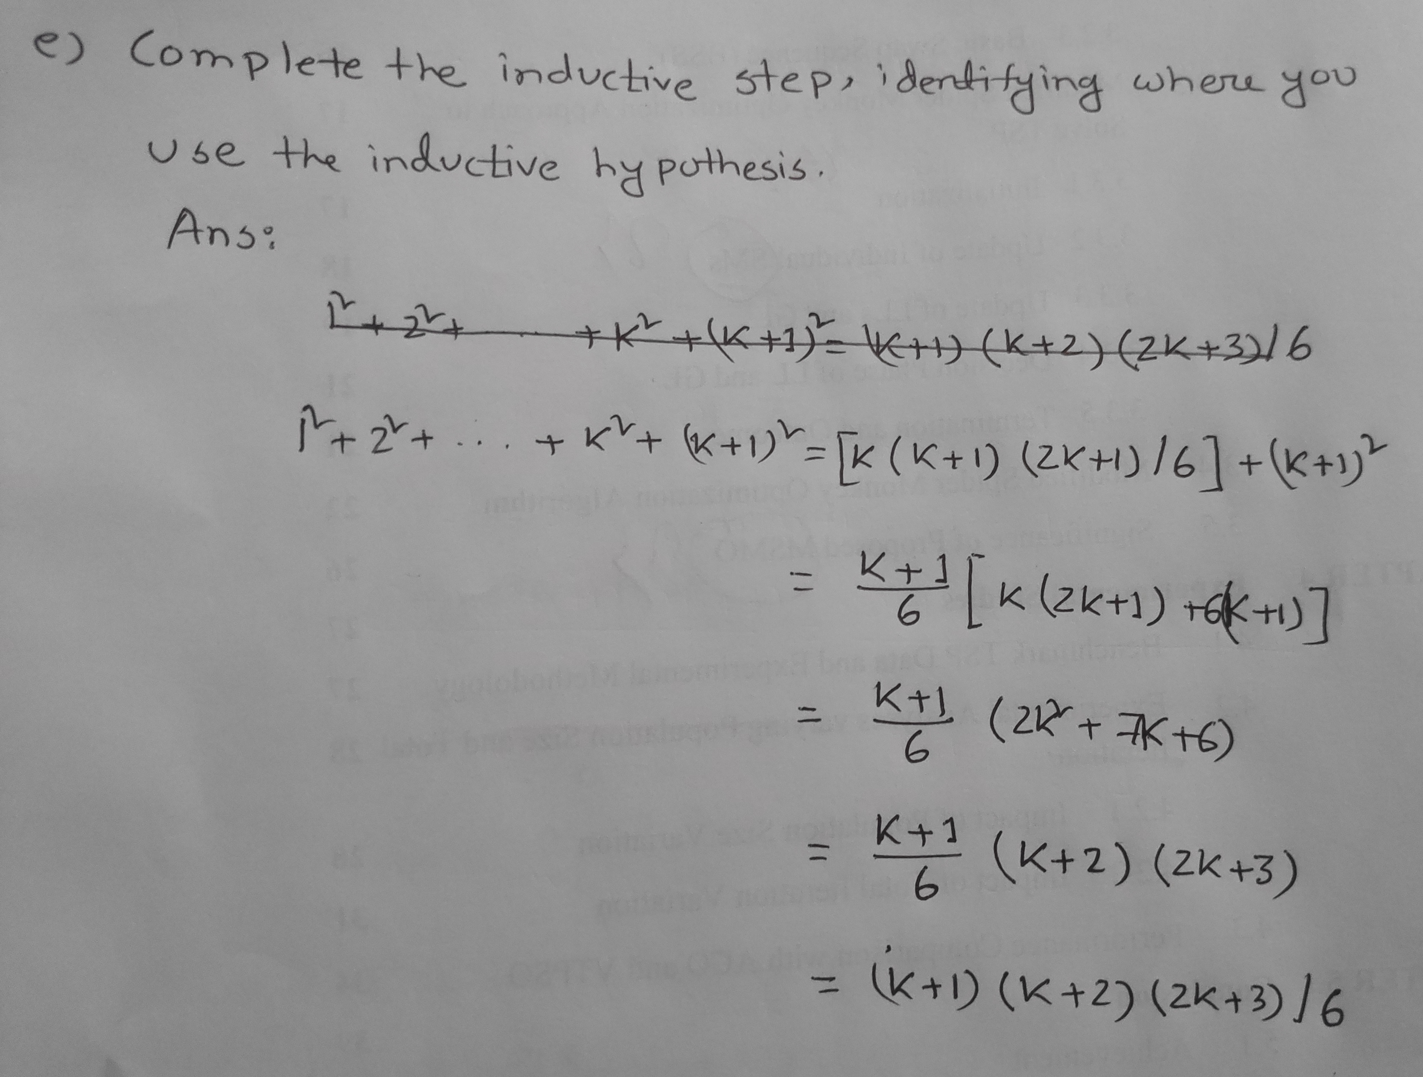

Slide 19
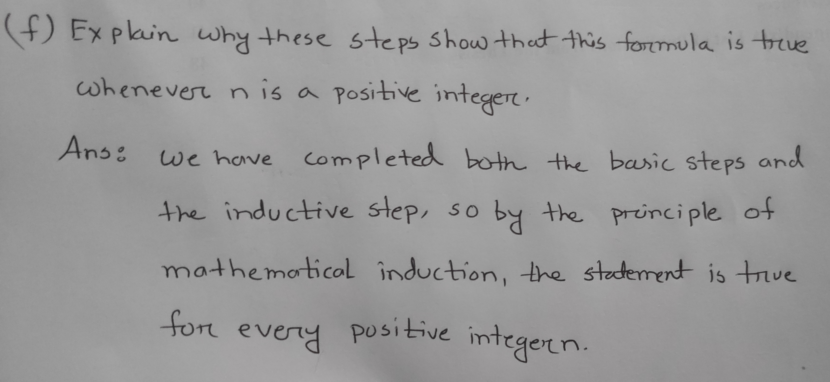

Slide 20
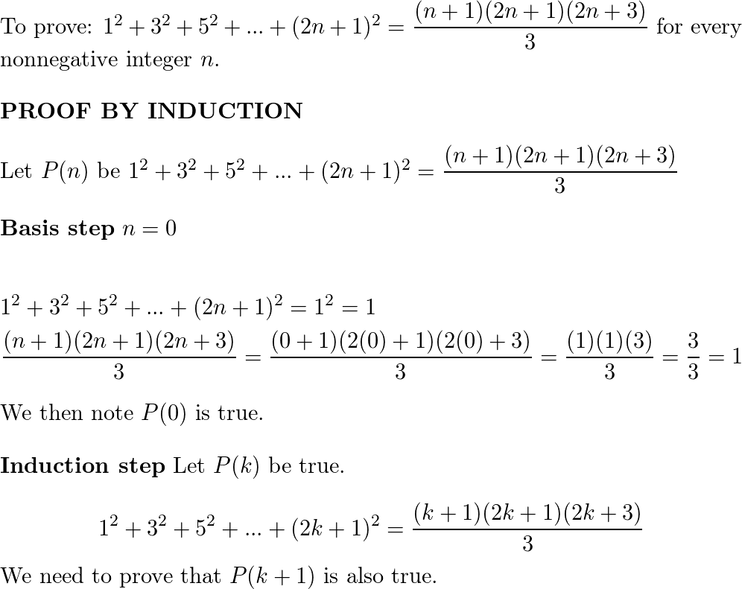
5

Slide 21
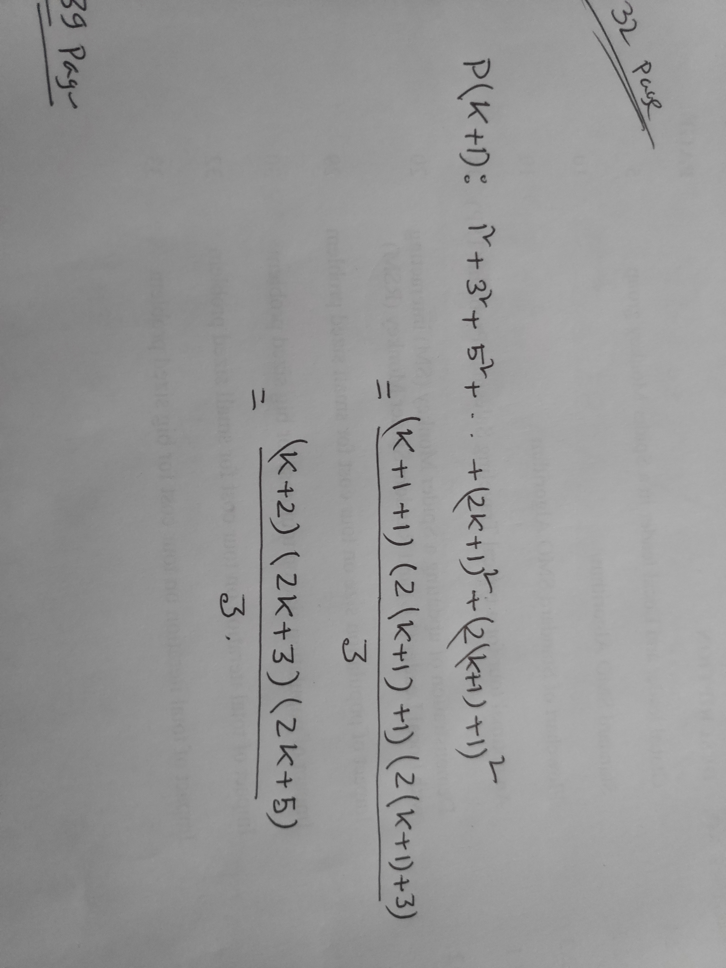

Slide 22
